Slide 1
AR Companion Application for Physical and Mental Health Especially for Elderly People
Choi Shin-yu
16.05.23
Final: Bachelor Informatik: Games Engineering
Advisor: Eichhorn, Christian; Dipl.-Inf.
Supervisor: Klinker, Gudrun Johanna; Univ.-Prof. Dr.

Slide 2
Introduction & Motivation
The emergence of an aging society
Demand for pets and its market is growing
Retirement of baby boomers is expected
Increasing Interest in Elderly Health
Expansion of urbanization
Expansion of smartphone penetration
Realization of virtual pets through advancements in AR technology
The rising trend of AR games

Slide 3
Problem Description: Issues
Signs of accelerating growth in the elderly population
Socioeconomic Issues of aging society
Rising expenditure on pets
Decrease in green spaces due to urbanization

Slide 4
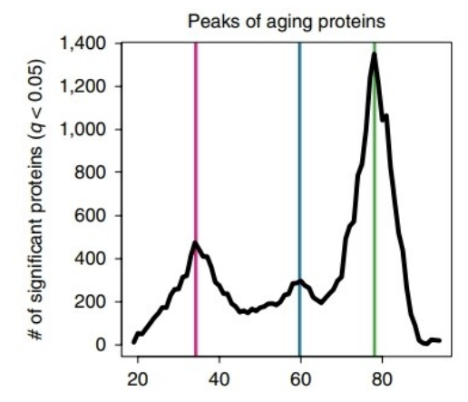
Existing Solutions & Related Work
3

Slide 5
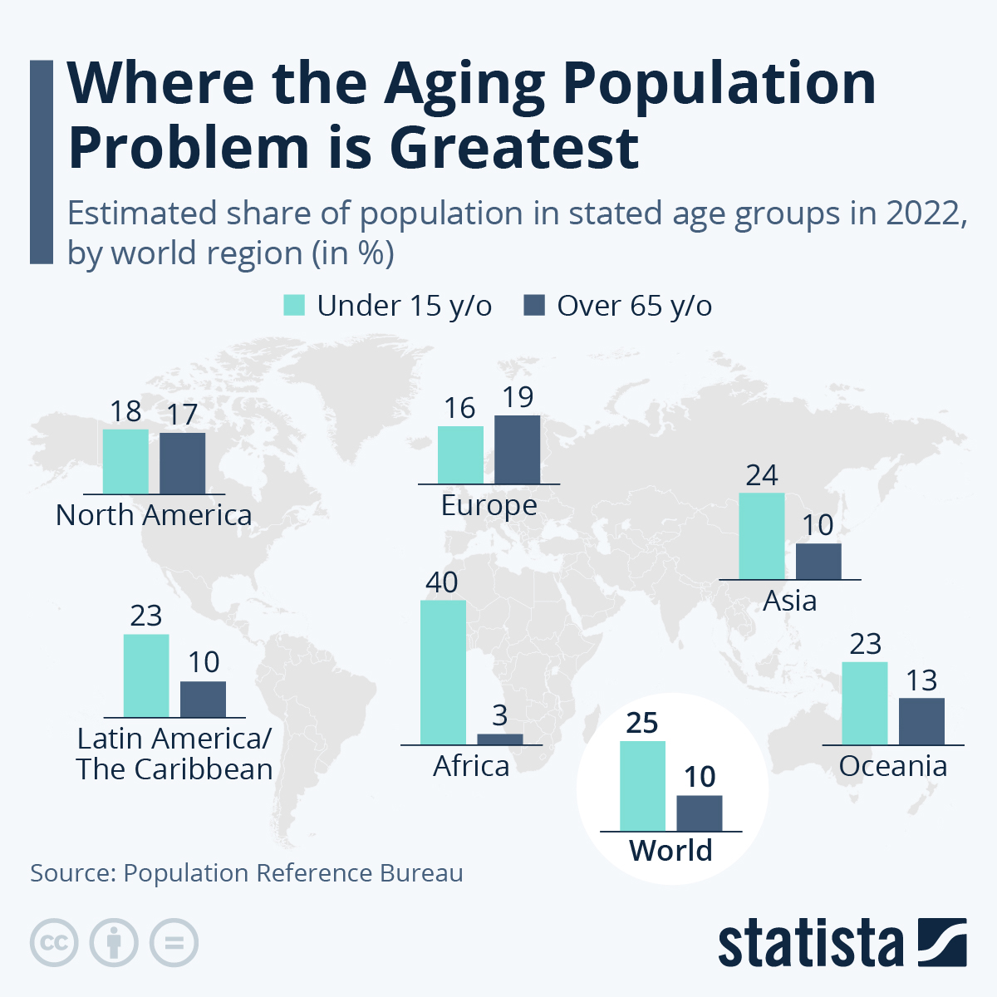
Existing Solutions & Related Work
1

Slide 6
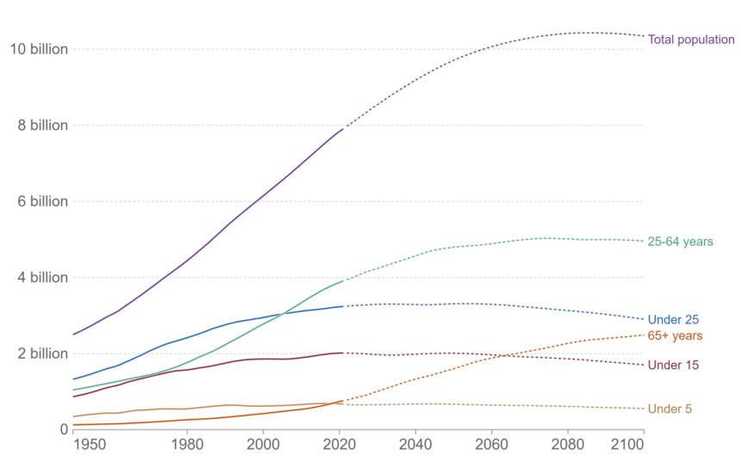
Existing Solutions & Related Work
2
Changes world population group by age

Slide 7
Existing Solutions & Related Work
Adults aged 65 and older need:
At least 150 minutes a week
At least 2 days a week of activities
Benefits of walk
Basic, but very effective exercise
Prevent cardiovascular disease
Strengthens bones and muscles
Mental health benefits
Improve memory and cognitive function

Slide 8
Existing Solutions & Related Work
Green space and health
Positive impact on mental and physical health
Opportunity for social interaction
Exposure to nature
Reduced stress, improve mood and increase cognitive function
Importance of motivation
Intrinsic motivation
Extrinsic motivation
Amotivation can lead to dropping out
Health care application & pet

Slide 9
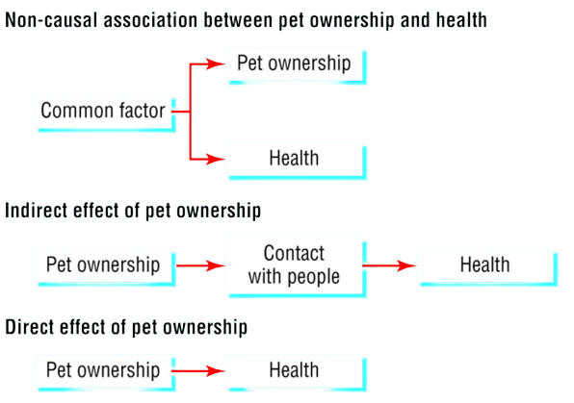
Existing Solutions & Related Work
Pet
5

Slide 10
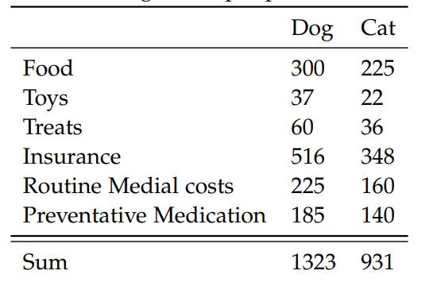
Existing Solutions & Related Work
Pet
Exposure to hazardous substances
Cost
4

Slide 11
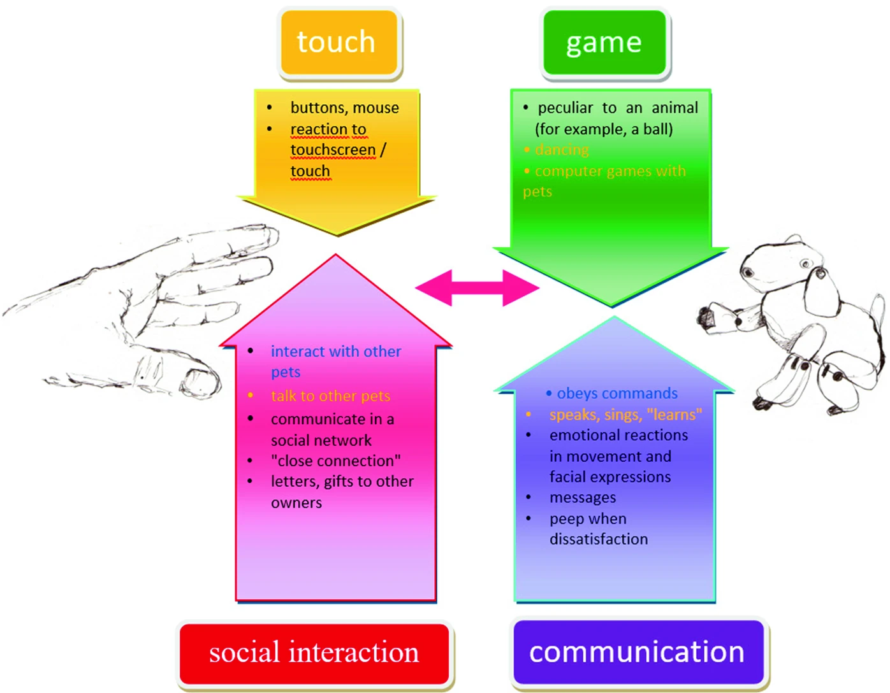
Existing Solutions & Related Work
Average physical performance by age
6

Slide 12
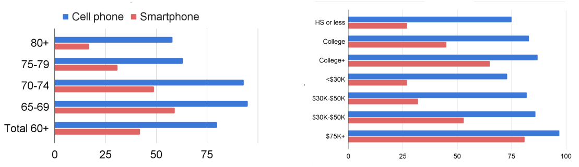
Existing Solutions & Related Work

Slide 13
Goals of this Thesis
What is the perception of people towards AR?
Can virtual pets serve as a source of motivation for exercise?
Can virtual pets provide the same level of emotional satisfaction as real pets?
Can virtual pets replace real pets?

Slide 14
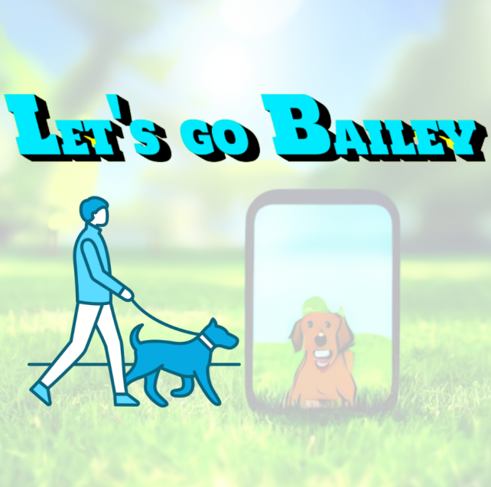
Approach
Source of motivation
Go for walk with pet
Item for pet
Emotional satisfaction
Interaction
Feed

Slide 15
Implementation
Main Menu
AR Scene
Shop Scene
Statistic
About
Exit
Interaction with pet
Buy/sell Items
Check previous exercise
Information about thesis
Get point
Preview items
GO Scene
Get point

Slide 16


Implementation

Slide 17
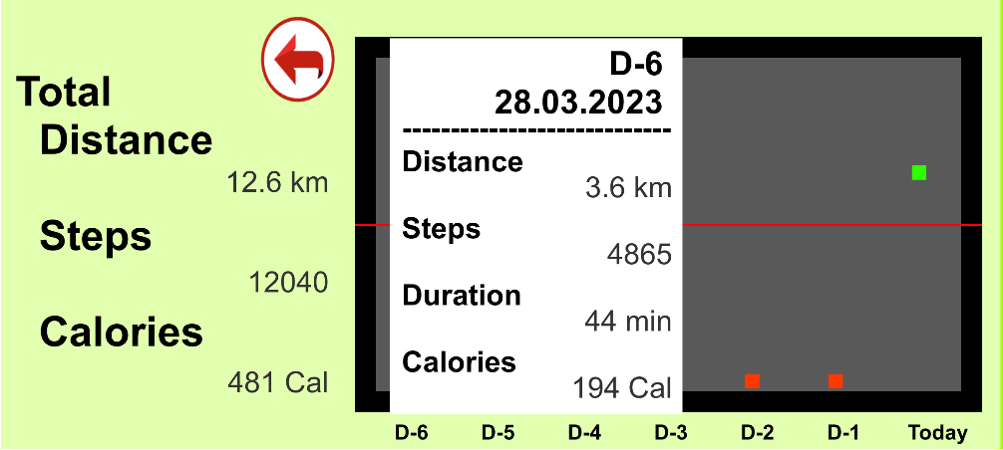
Implementation

Slide 18
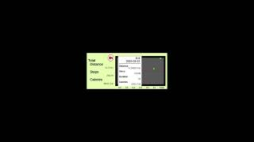
Implementation

Slide 19

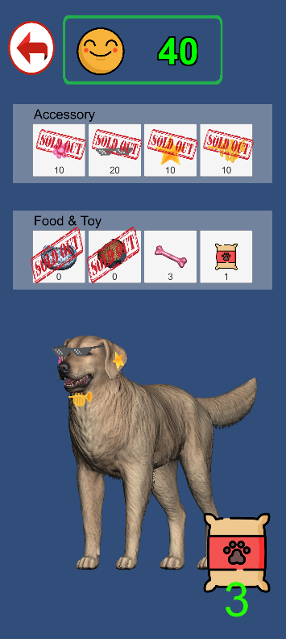
Implementation

Slide 20
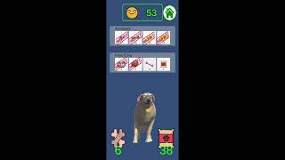
Implementation

Slide 21

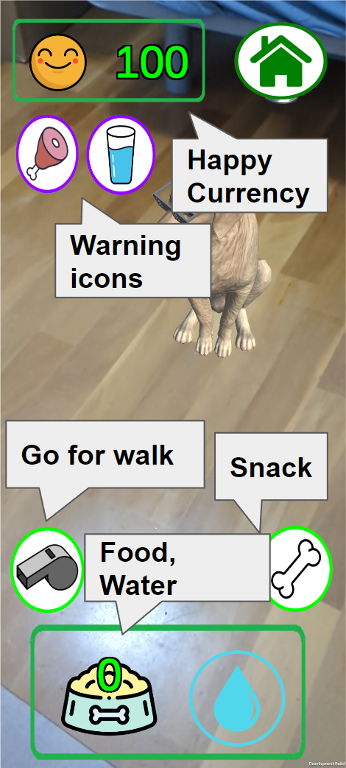
Implementation

Slide 22
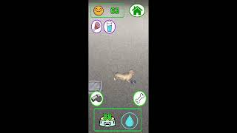
Implementation

Slide 23
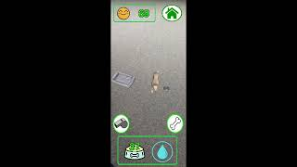
Implementation

Slide 24
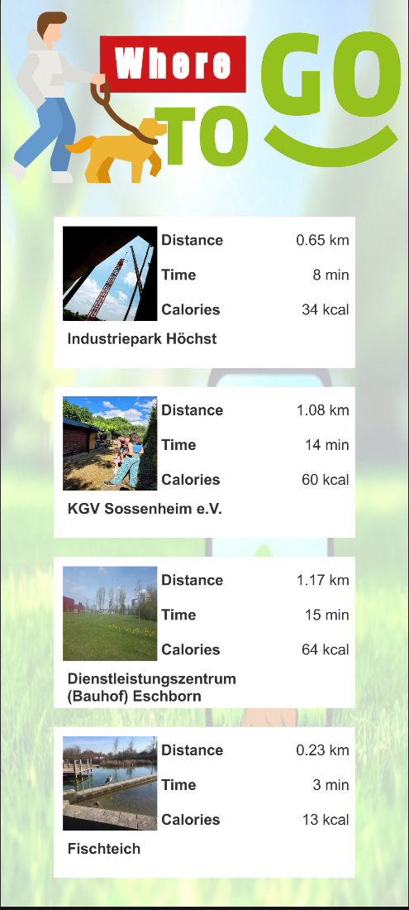
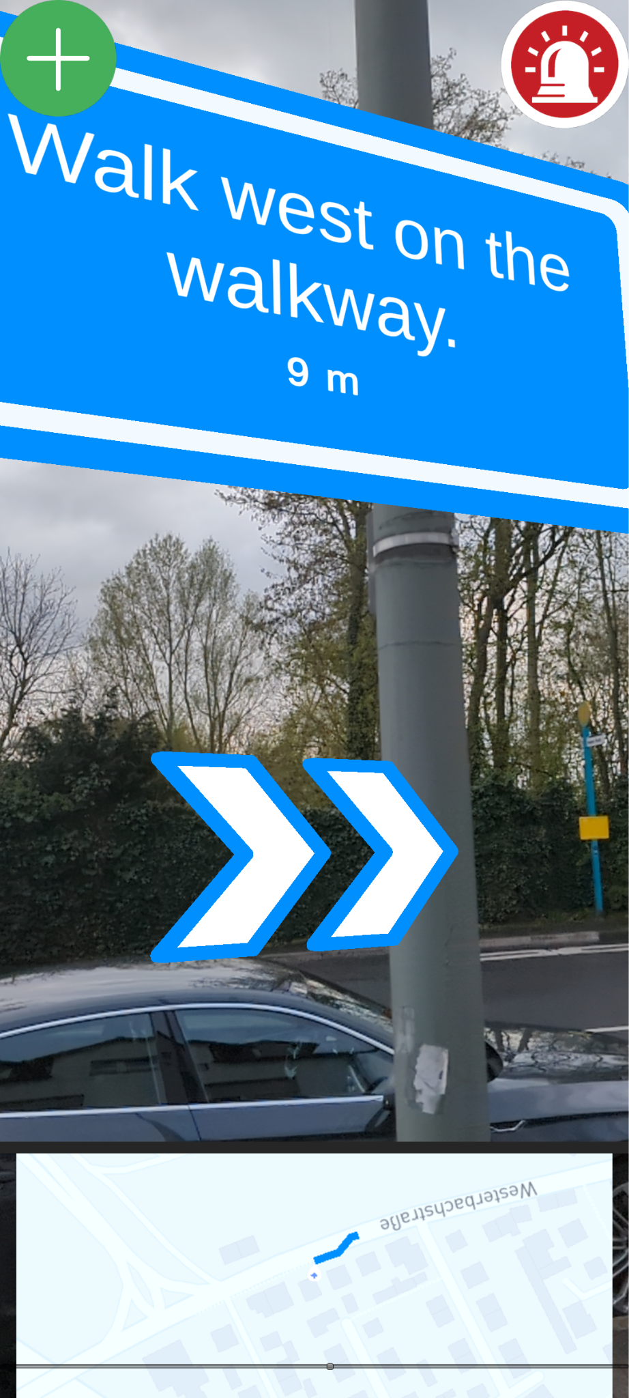
Implementation

Slide 25
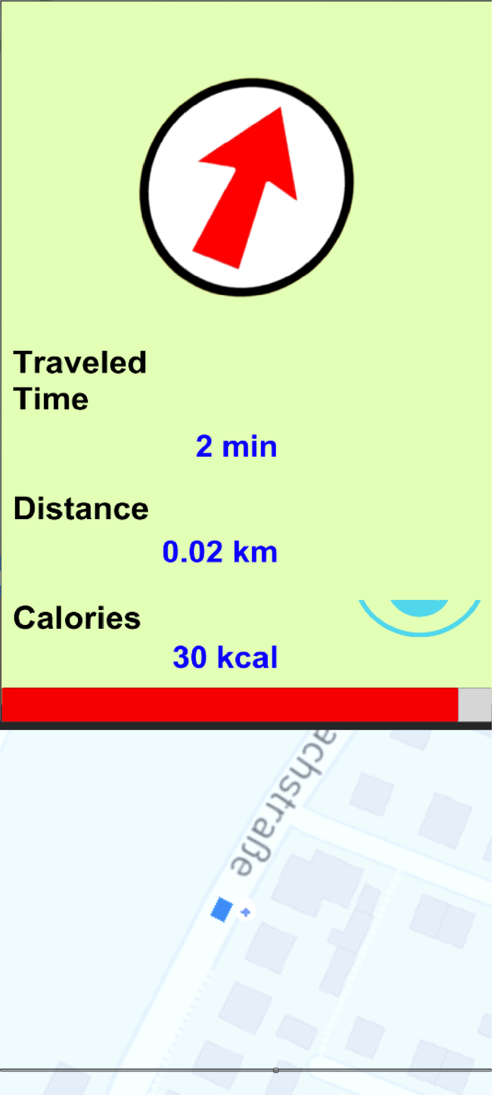
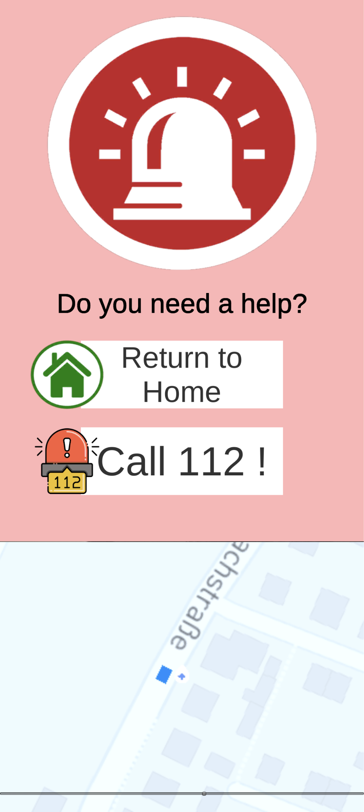
Implementation

Slide 26
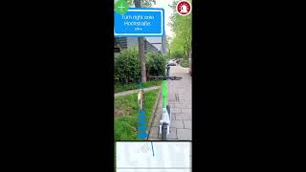
Implementation

Slide 27
Evaluation
Questionnaire
Interview : 9 (3)
Online survey: 25 (3)
Subject of the question
About pet
Interest in technology and AR game
About the application

Slide 28
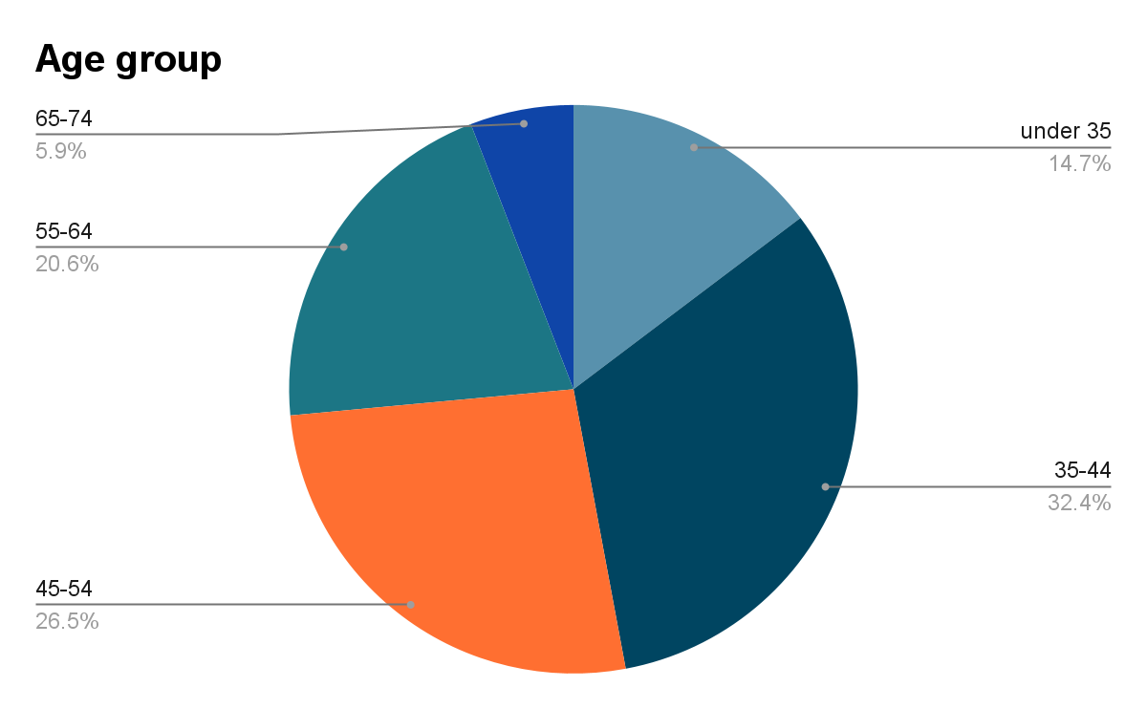
Evaluation

Slide 29
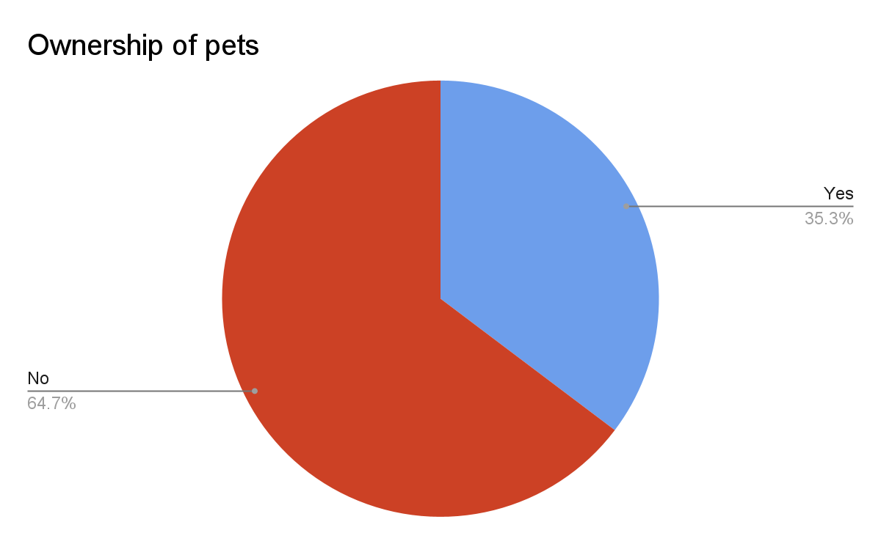
Evaluation

Slide 30
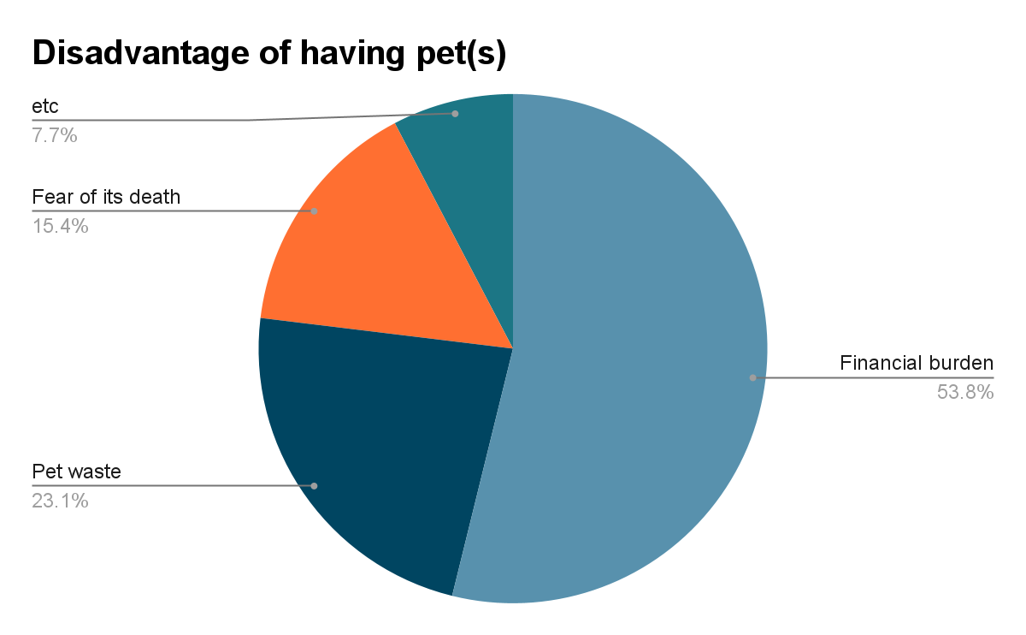
Evaluation
Advantage of having pet(s) : Emotional stability(100%)
Disadvantage

Slide 31
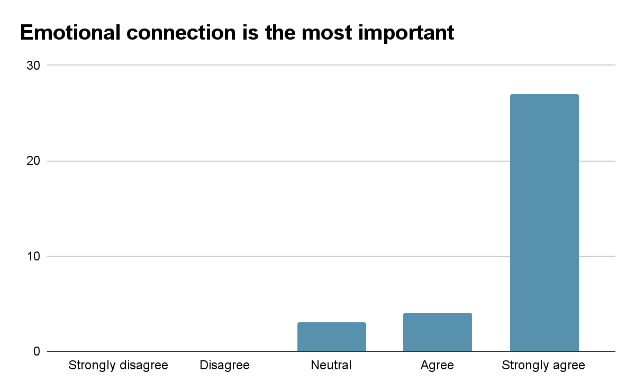
Evaluation

Slide 32
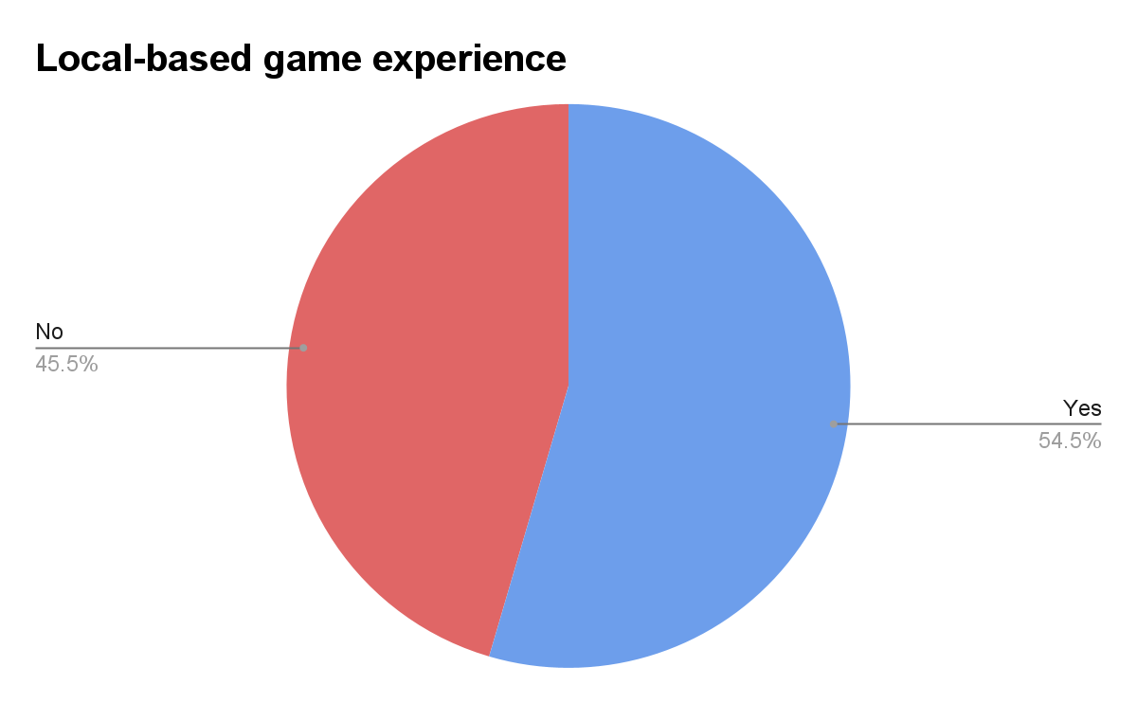
Evaluation

Slide 33
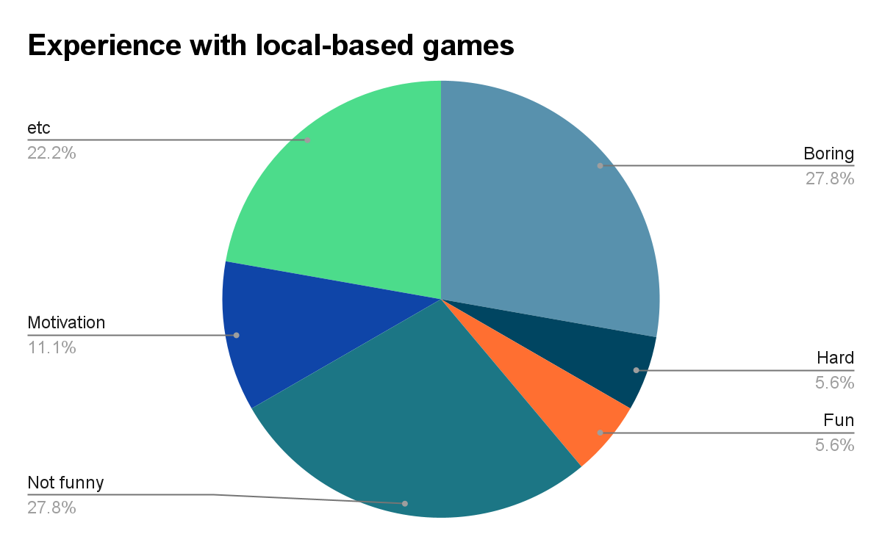
Evaluation

Slide 34
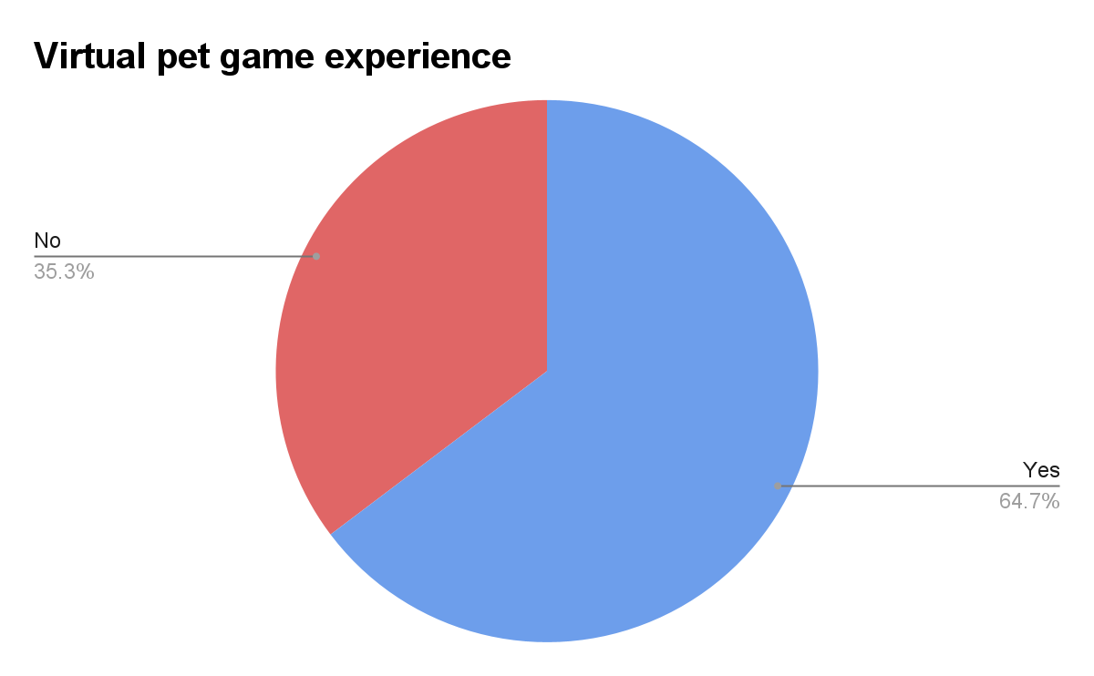
Evaluation

Slide 35
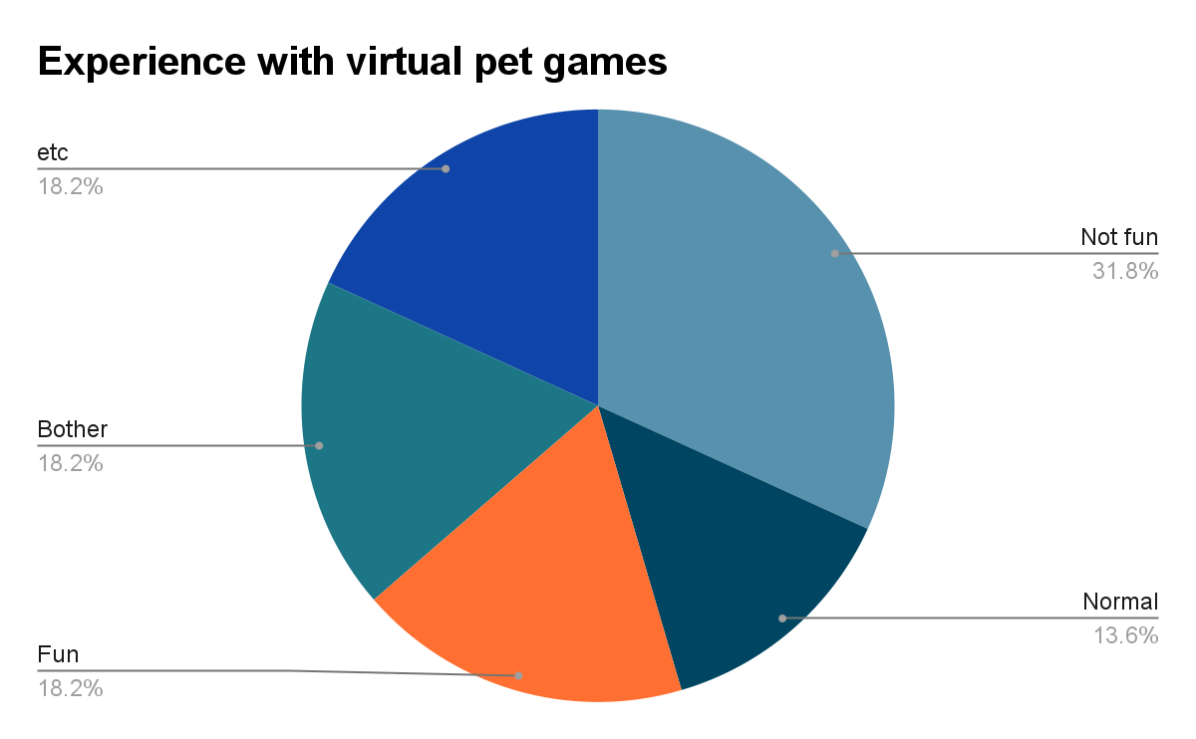
Evaluation

Slide 36
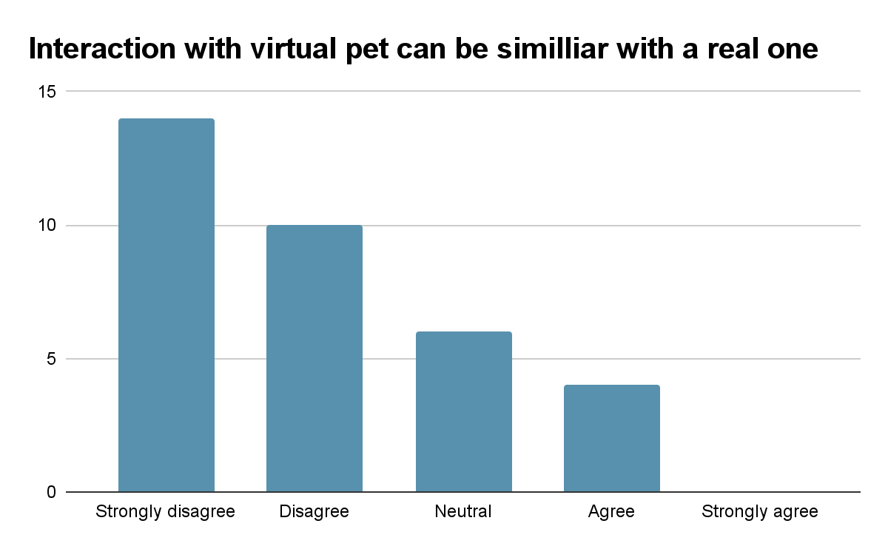
Evaluation

Slide 37
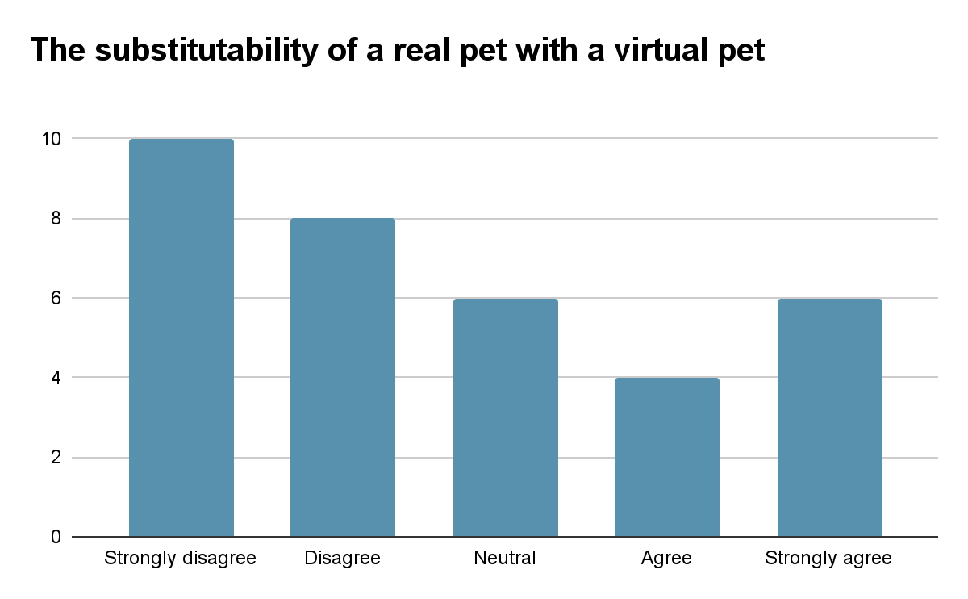
Evaluation

Slide 38
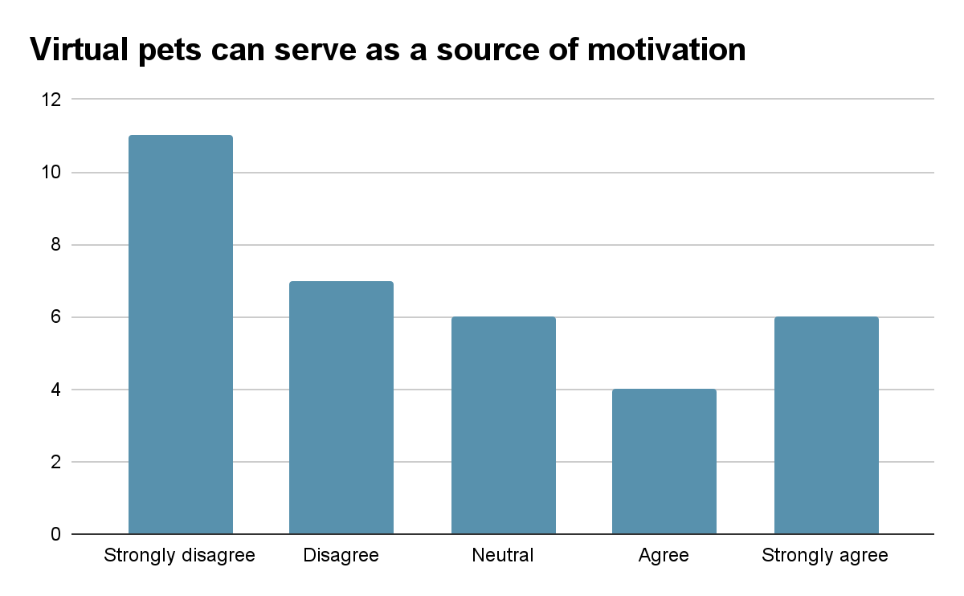
Evaluation

Slide 39
Evaluation
An evaluation of the application
Mostly positive feedback
The lack of realism and content variety
Other opinions
Limitations
Inaccuracy of mobile GPS
Challenges Mobile AR Camera and ARCore
Inaccuracy of metabolic cost
Challenges for recommending green spaces

Slide 40
Discussion
Technical potential
Enhancing the realism of virtual pets
Customization
More contents
Content potential
Multiplayer and community
Virtual pet modeled after the user's previously owned and cared
Special virtual pet

Slide 41
Conclusion
Virtual pets have the potential to provide satisfaction to people who can not own and raise real pets
The lack of content due to technological limitations.
The advancement and improvement of algorithms, cameras, and sensors are necessary
To ensure a positive user experience
Community function
More dynamic contents
Customization

Slide 42
List of References
https://www.statista.com/chart/28583/share-of-world-population-under-15-over-65-by-region/
2. M. R. Hannah Ritchie. Age Structure. 2019. url: https://ourworldindata.org/ age - structure # what - does - the - age - structure - of - future - populations - look-like.
3. B. L. et al. “Undulating changes in human plasma proteome profiles across the lifespan”.
4. A. S. for the Prevention of Cruelty to Animals(ASPCA). Cutting Pet Care Costs
5. A. R. June McNicholas Andrew Gilbey. “Pet ownership and human health: a brief review of evidence and issues”
6. D. B. et al. “Virtual Pet: Trends of Development”

Slide 43
List of References
7. G. B. et al. “The age-performance relationship in the general population and strategies to delay age related decline in performance”.
8. https://www.cdc.gov/physicalactivity/basics/
older_adults/index.htm
9. B. H. Channel. Walking for good health. url: https://www.betterhealth.vic.gov.au/health/healthyliving/walking-for-good-health.
10. R. M. e. a. Ryan. “Self-determination theory and the facilitation of intrinsic motivation, social development, and well-being.”
11. P. research center. Tech Adoption Climbs Among Older Adults. u

Slide 44
List of References
12. M. Bozkurt. “Metropolitan children’s physical fitness: The relationship between overweight and obesity prevalence, socioeconomic status, urban green space access, and physical activity”

